Slide 1
Sports Score Tracker
By: Jason Jacob, Christian Cox, and David Morrison

Slide 2
Proposal Statement
Baseball league in Lexington
Tracks league information (teams, games, scores, standings) on paper
Manual updates required
Online league tracking needed
Multi-league and multi-team tracking needed
Ability for coaches, parents, players, fans, and general public to view all league info also needed

Slide 3
User Requirements
Web-based
Track schedules, scores and standings for user-created sports, leagues, and teams
Users can vote on outcome of games
Users can view and post comments on injuries, scores, or general info
Smart Outcome Prediction System, takes into account team’s win / loss record

Slide 4
Cost Estimation
Effort Equation
E = 2.4 * (KDSI) ^ 1.05
E = 2.4 * 5 ^ 1.05
E = 13 person months
Schedule Equation
TDEV = 2.5 * (E) ^ 0.38
TDEV = 2.5 * 13 ^ 0.38
TDEV = 7 months
Productivity = 5000 DSI / 13 person months = 385 DSI / PM
Average Staffing = 13 PM / 7 months = 2 people
Actual Average Staffing = 13 PM / 4 months = 3 people

Slide 5
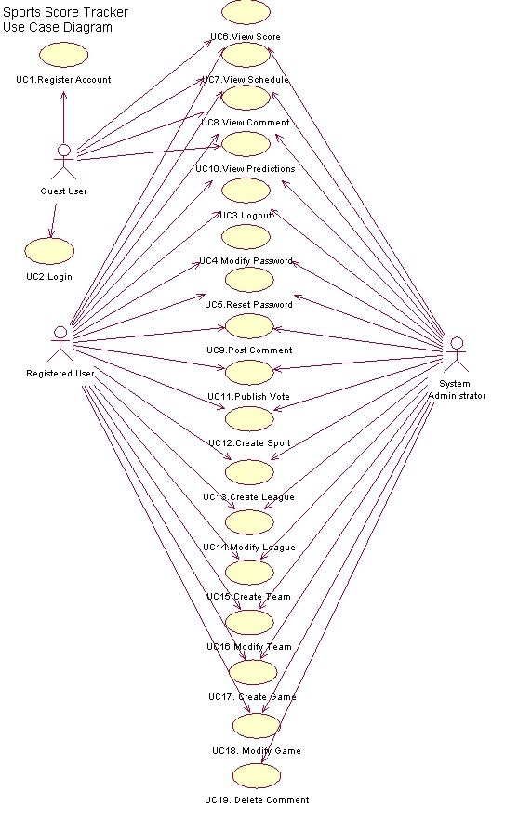

Slide 6
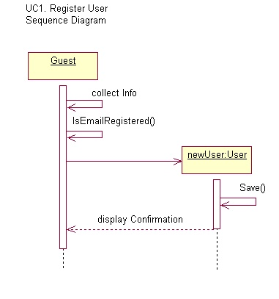

Slide 7
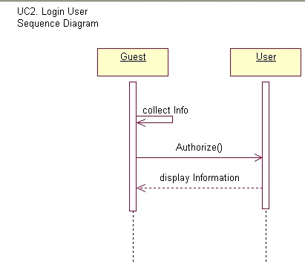

Slide 8
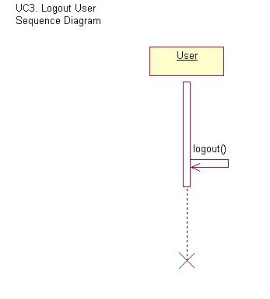

Slide 9
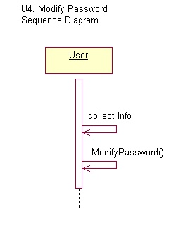

Slide 10
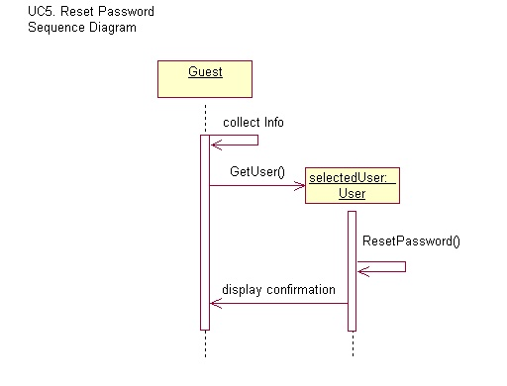

Slide 11
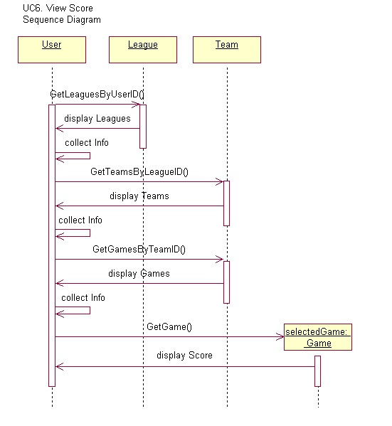

Slide 12
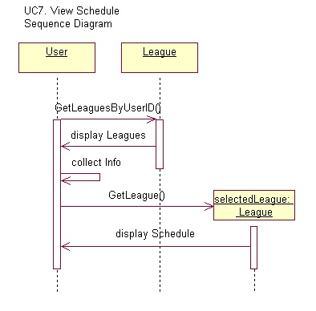

Slide 13
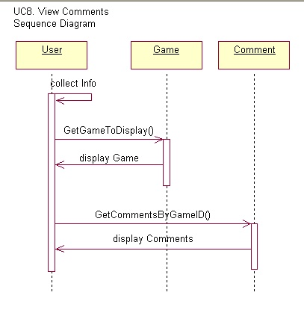

Slide 14
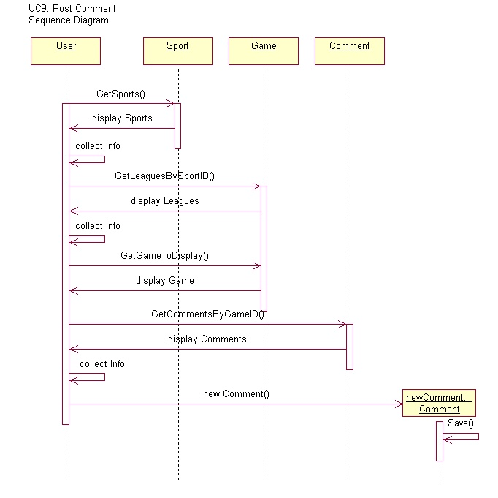

Slide 15
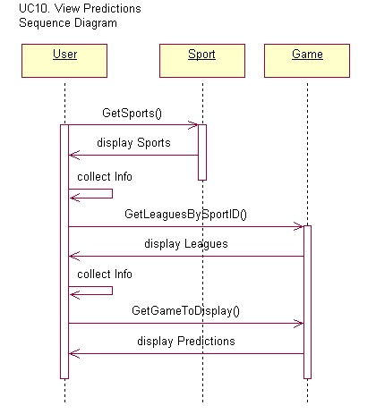

Slide 16
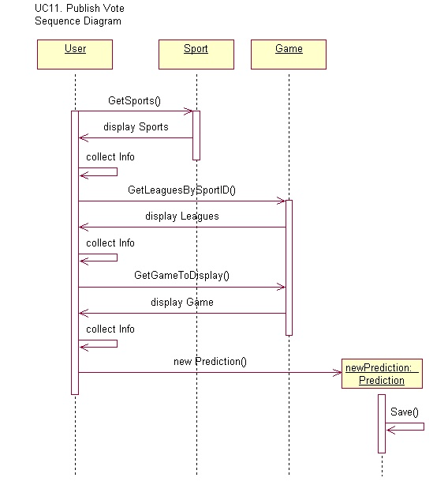

Slide 17
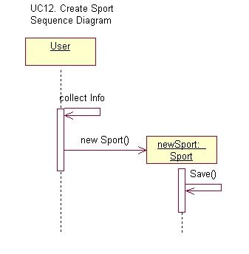

Slide 18
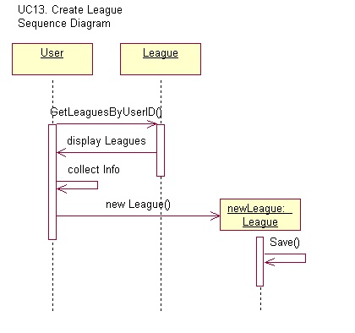

Slide 19
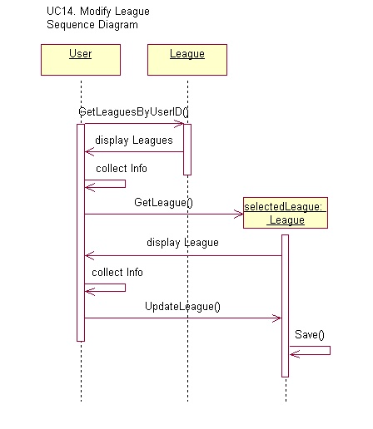

Slide 20
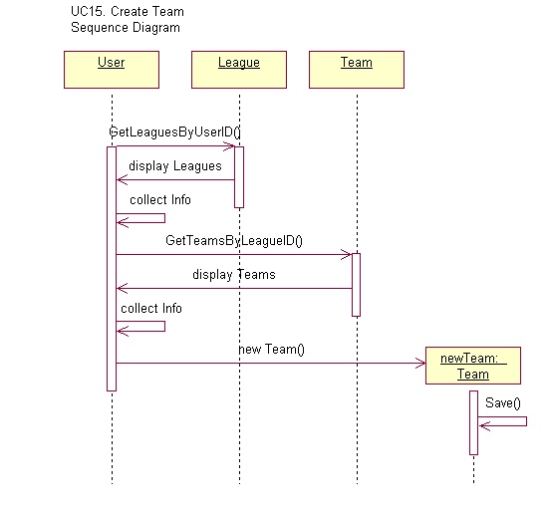

Slide 21
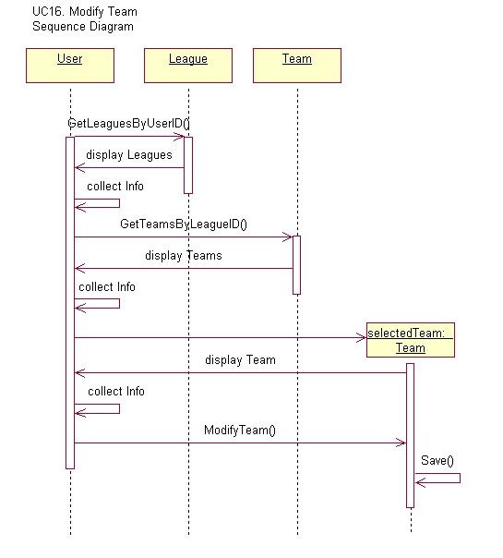

Slide 22
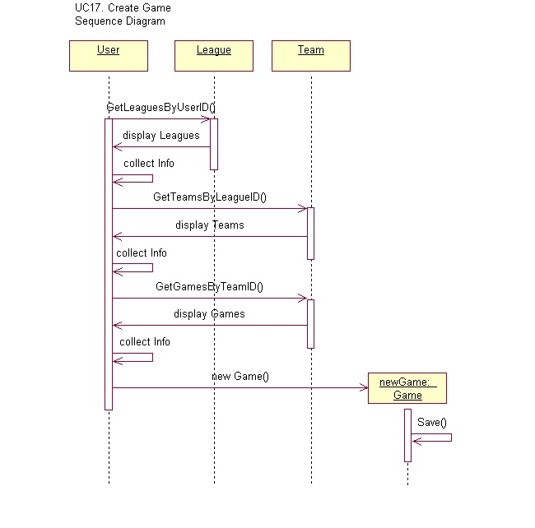

Slide 23
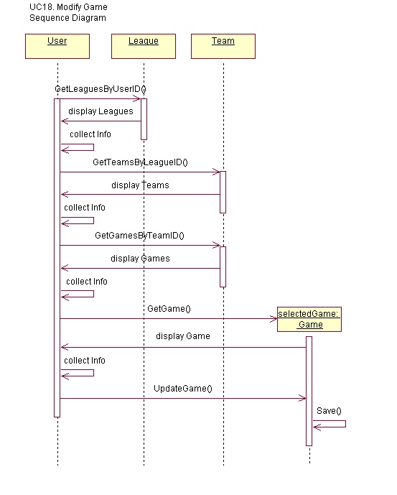

Slide 24
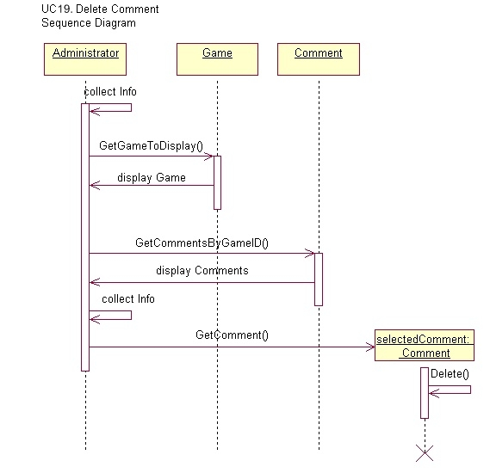

Slide 25
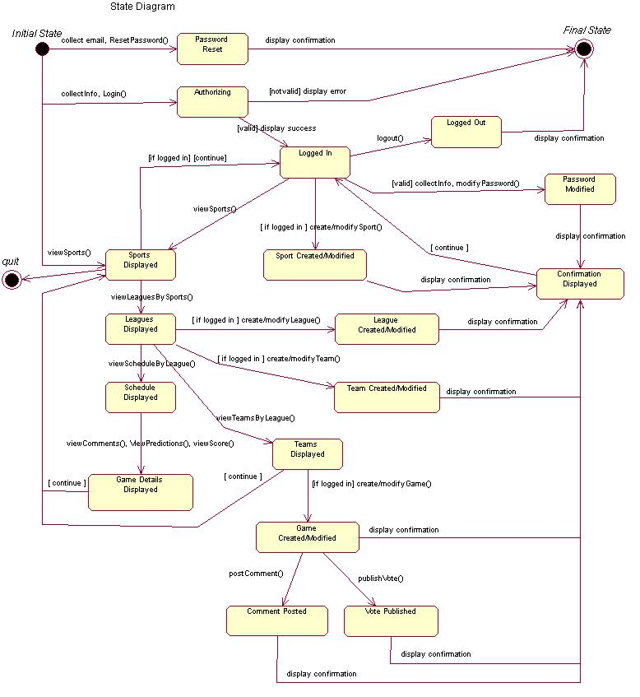

Slide 26
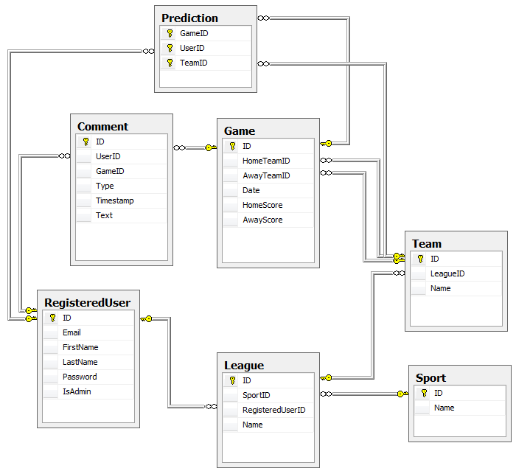

Slide 27
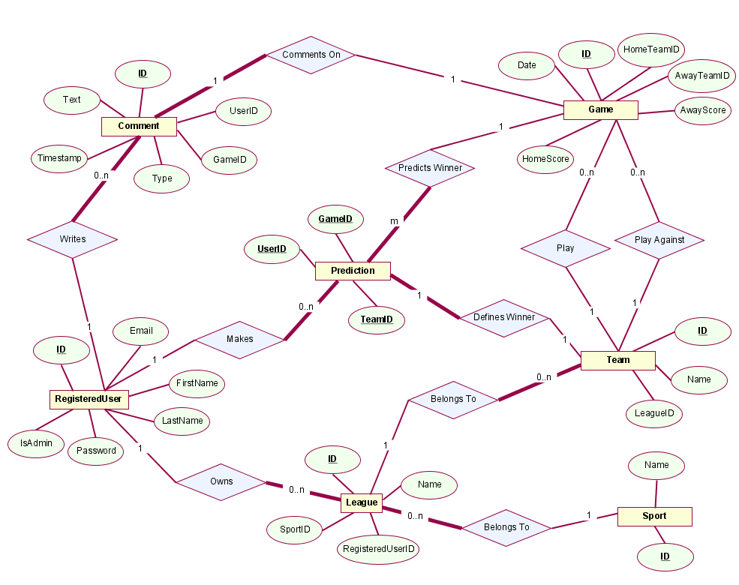
ER Model

